Slide 1
CS3006 Parallel and Distributed Computing
FALL 2021
National University of Computer and Emerging Sciences

Slide 2
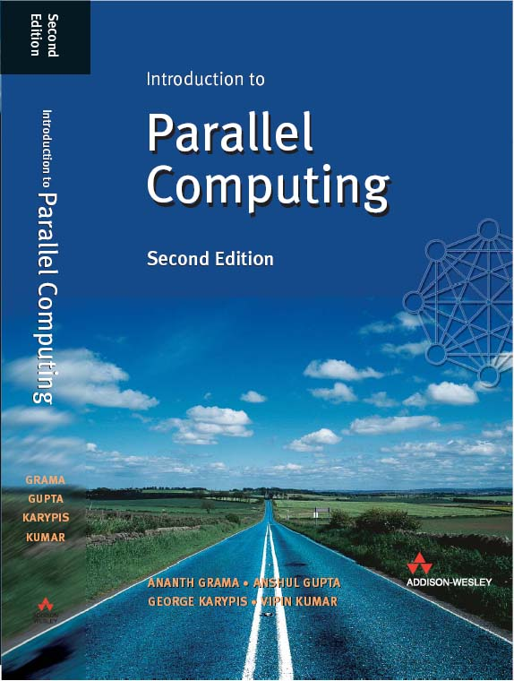
Instructor
Muhammad Danish Khan
Lecturer, Department of Computer Science
FAST NUCES Karachi
m.danish@nu.edu.pk
Recommended Text Book
Introduction to Parallel Computing, Second Edition
by Ananth Grama

Slide 3
Marks Distribution and Deadlines
Assessment | Weightage | Schedule/Deadlines/ Remarks
Mid-term I Examinations | 15 | 6th Week
Mid-term II Examinations | 15 | 12th Week
Tasks/Assignments | 10 | 1-2 Assignment Tasks per Week with Plagiarism Checking
Semester Project | 10 | Project idea submission: 7th week, Final Submission due in 15th - 16th Week
Final Examinations | 50 | Comprehensively from all the covered and assigned topics.

Slide 4
Pre-Requisite
Operating System Concepts
Algorithms

Slide 5
Semester Plan
Week 1: Revision of Operating System Concepts
Week 2: Introduction to Parallel Computing, Assignment Task(s)
Week 3: Parallel Programming Platforms
Week 4: Parallel Programming Platforms , Assignment Task(s)
Week 5: Principles of Parallel Algorithm Design, Quiz-1
Week 6: Mid Term-1 Examinations

Slide 6
Semester Plan
Week 7: Principles of Parallel Algorithm Design, Assignment Task(s), Project Proposal Submission
Week 8: Programming Shared Address Space
Week 9: Programming Shared Address Space
Week 10: Programming Shared Address Space, Assignment Task(s)
Week 11: Programming Using the Message Passing Paradigm, Quiz-2
Week 12: Mid Term-2 Examinations

Slide 7
Semester Plan
Week 13: Programming Using the Message Passing Paradigm, Assignment Task(s)
Week 14: Distributed System Models and Enabling Technologies, Assignment Task(s)
Week 15: Distributed System Models and Enabling Technologies, Quiz-3, Project Evaluations
Week 16: Distributed System Models and Enabling technologies, Project Evaluations

Slide 8
LMS: Google Class Room
Section 5C Class Code: eg2u47t
https://classroom.google.com/c/Mzg4NTA1MTMzNDI3?cjc=eg2u47t

Slide 9
Operating System Concepts Revision
Program
Set of instructions and associated data
resides on the disk and is loaded by the operating system to perform some task.
E.g. An executable file or a python script file.
Process
A program in execution.
In order to run a program, the operating system's kernel is first asked to create a new process, which is an environment in which a program executes.
consists of instructions, user-data, and system-data segments, CPU, memory, address-space, disk acquired at runtime

Slide 10
Thread
the smallest unit of execution in a process.
A thread simply executes instructions serially.
A process can have multiple threads running as part of it.
Processes don't share any resources amongst themselves whereas threads of a process can share the resources allocated to that particular process, including memory address space.

Slide 11
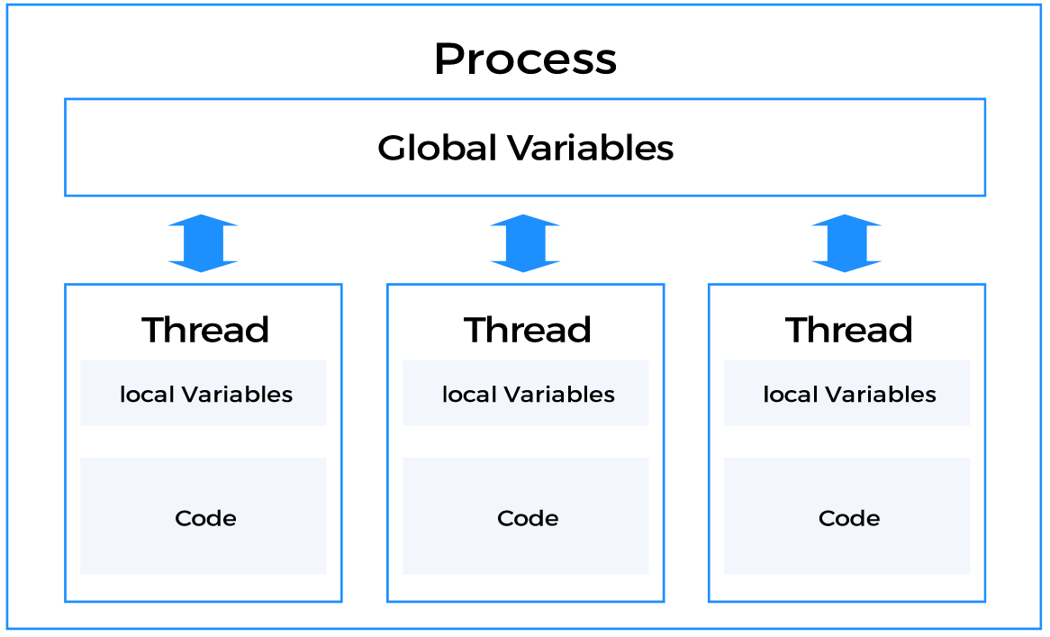
Notes:
An execution state (Running, Ready, etc.)
Saved thread context when not running
Suspending a process involves suspending all threads of that process
Termination of a process terminates all threads within the process

Slide 12
“Multiprocessing systems”
where multiple processes get scheduled on more than one CPU.
Usually, this requires hardware support where a single system comes with multiple cores
or the execution takes place in a cluster of machines.
Multiple Processors vs Multiple Cores

Slide 13
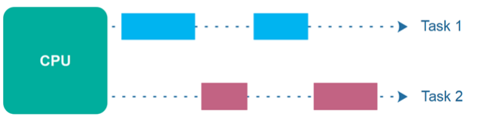
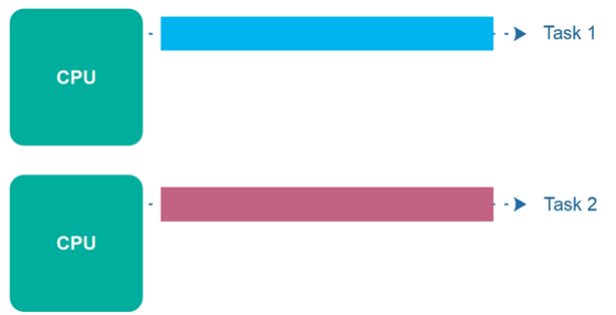
Concurrency
Parallel Execution

Slide 14
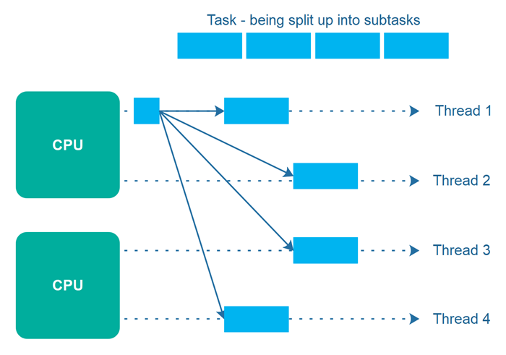
Parallelism
The term parallelism means that an application splits its tasks up into smaller subtasks which can be processed in parallel, for instance on multiple CPUs at the exact same time.

Slide 15
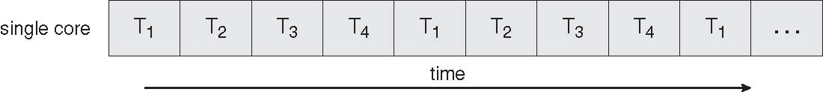
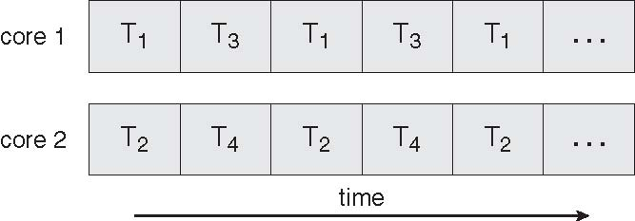
Concurrent Execution on a Single-core System
Serial Execution vs. Parallel Execution
Parallel Execution on a Multicore System

Slide 16
Limitations of Serial Computing
Limits to serial computing - both physical and practical reasons pose significant constraints to simply building ever faster serial computers.
Transmission speeds - the speed of a serial computer is directly dependent upon how fast data can move through hardware.
Absolute limits are the speed of light (30 cm/nanosecond) and the transmission limit of copper wire (9 cm/nanosecond). Increasing speeds necessitate increasing proximity of processing elements.
Economic limitations - it is increasingly expensive to make a single processor faster.
Using a larger number of moderately fast commodity processors to achieve the same (or better) performance is less expensive.

Slide 17
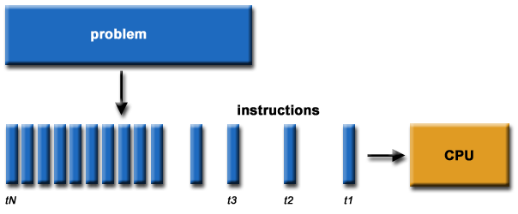
Parallel Computing
Traditionally, software has been written for serial computation:
To be run on a single computer having a single Central Processing Unit (CPU);
A problem is broken into a discrete series of instructions.
Instructions are executed one after another.
Only one instruction may execute at any moment in time.

Slide 18
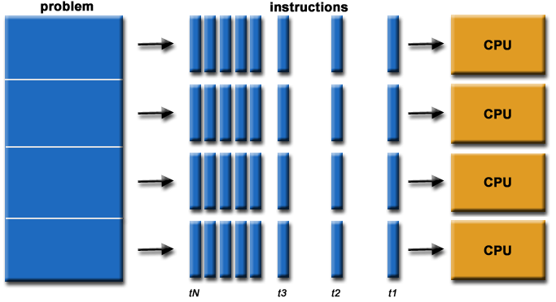
Parallel Computing
In the simplest sense, parallel computing is the simultaneous use of multiple computing resources to solve a computational problem.
To be run using multiple CPUs
A problem is broken into discrete parts that can be solved concurrently
Each part is further broken down to a series of instructions
Instructions from each part execute simultaneously on different CPUs

Slide 19


Parallel Computing: Resources
The compute resources can include:
A single computer with multiple processors;
A single computer with (multiple) processor(s) and some specialized computer resources (GPU, FPGA …)
An arbitrary number of computers connected by a network (Cluster)
A combination of both.

Slide 20
Parallel Computing: The computational problem
The computational problem usually demonstrates characteristics such as the ability to be:
Broken apart into discrete pieces of work that can be solved simultaneously;
Execute multiple program instructions at any moment in time;
Solved in less time with multiple compute resources than with a single compute resource.
Notes:
Dependence between codes

Slide 21
LD $12, (100)
ADD $11, $12
SUB $10, $11
INC $10
SW $13, ($10)
Notes:
Task: Take some code (having more than 30 instructions) and map them to different computing resources for parallel execution. Also identify dependence

Slide 22
int sample1
{
X = sample2()
Return x;
}
float sample3
{
Pi=3.14
Return pi
}
Int sample2()
{
Cin>>I
Return I;
}

Slide 23
Parallel Computing: what for?
Example applications include:
Parallel Databases, Data Mining
Web Search Engines, Web Based Business Services
Computer-aided diagnosis in medicine
advanced graphics and virtual reality, particularly in the entertainment industry
networked video and multi-media technologies

Slide 24
Why Parallel Computing?
Save time
Solve larger problems
Provide parallelism (do multiple things at the same time)
… ..

Slide 25
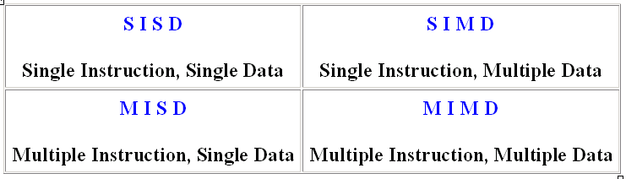
Flynn Taxonomy
Based on the number of concurrent instruction (single or multiple) and data streams (single or multiple) available in the architecture
Notes:
Flynn's taxonomy is a specific classification of parallel computer architectures that are based on the number of concurrent instruction (single or multiple) and data streams (single or multiple) available in the architecture

Slide 26
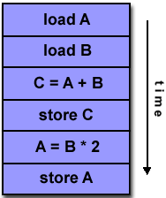
Single Instruction, Single Data (SISD)
It represents the organization of a single computer containing a control unit, processor unit and a memory unit.
Single instruction: only one instruction stream is being acted on by the CPU during any one clock cycle
Single data: only one data stream is being used as input during any one clock cycle
A single processor executes a single instruction stream, to operate on data stored in a single memory.
This is the oldest and until recently, the most prevalent form of computer
Examples: most PCs, single CPU workstations and mainframes

Slide 27
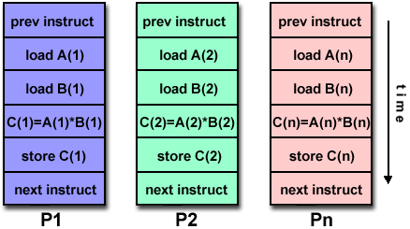
Single Instruction, Multiple Data (SIMD)
Single instruction: All processing units execute the same instruction at any given clock cycle
Multiple data: Each processing unit can operate on a different data element
The processing units are made to operate under the control of a common control unit, thus providing a single instruction stream and multiple data streams.
Best suited for specialized problems characterized by a high degree of regularity, such as image processing.
Two varieties: Processor Arrays and Vector Pipelines
Examples:
Processor Arrays: Connection Machine CM-2, Maspar MP-1, MP-2
Vector Pipelines: IBM 9000, Cray C90, Fujitsu VP, NEC SX-2, Hitachi S820
Notes:
Array processors are also known as multiprocessors or vector processors. They perform computations on large arrays of data. Thus, they are used to improve the performance of the computer.
e.g. Vector processing performs the arithmetic operation on the large array of integers or floating-point number. Vector processing operates on all the elements of the array in parallel providing each pass is independent of the other.
To avoid the overhead of processing loops and fasten the computation, some kind of parallelism must be introduced. Vector processing operates on the entire array in just one operation i.e. it operates on elements of the array in parallel. But, vector processing is possible only if the operations performed in parallel are independent.
They are basically used for numerical problems that are expressed in the form of vector or matrix.

Slide 28
50 X 50
{1,2,3,4,5,6,7,8,9,10}
TWICE (*2) Every Element (2500)
MUL 2

Slide 29
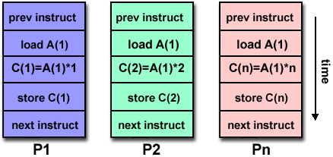
Multiple Instruction, Single Data (MISD)
A single data stream is fed into multiple processing units.
It consists of a single computer containing multiple processors connected with multiple control units and a common memory unit
Each processing unit operates on the data independently via independent instruction streams.
Some conceivable uses might be:
multiple frequency filters operating on a single signal stream
Notes:
it is capable of processing several instructions over single data stream simultaneously.
MISD structure is only of theoretical interest since no practical system has been constructed using this organization.

Slide 30
LD $3, ($12)
ADD $4, $12
OR $7, $12

Slide 31
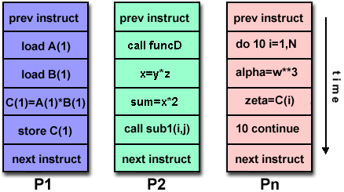
Multiple Instruction, Multiple Data (MIMD)
Currently, the most common type of parallel computer. Most modern computers fall into this category.
It represents the organization which is capable of processing several programs at same time.
Multiple Instruction: every processor may be executing a different instruction stream
Multiple Data: every processor may be working with a different data stream
Execution can be synchronous or asynchronous, deterministic or non-deterministic
Examples: most current supercomputers, networked parallel computer "grids" and multi-processor SMP computers - including some types of PCs.

Slide 32
Some General Parallel Terminology
Task/Process
A logically discrete section of computational work. A task is typically a program or program-like set of instructions that is executed by a processor.
Parallel Task
A task that can be executed by multiple processors safely (yields correct results)
Serial Execution
Execution of a program sequentially, one statement at a time. In the simplest sense, this is what happens on a one processor machine. However, virtually all parallel tasks will have sections of a parallel program that must be executed serially.

Slide 33
Parallel Execution
Execution of a program by more than one task, with each task being able to execute the same or different statement at the same moment in time.
Shared Memory
From a strictly hardware point of view, describes a computer architecture where all processors have direct (usually bus based) access to common physical memory.
In a programming sense, it describes a model where parallel tasks all have the same "picture" of memory and can directly address and access the same logical memory locations regardless of where the physical memory actually exists.
Distributed Memory
In hardware, refers to network based memory access for physical memory that is not common. As a programming model, tasks can only logically "see" local machine memory and must use communications to access memory on other machines where other tasks are executing.

Slide 34
Communications
Parallel tasks typically need to exchange data. There are several ways this can be accomplished, such as through a shared memory bus or over a network, however the actual event of data exchange is commonly referred to as communications regardless of the method employed.
Synchronization
The coordination of parallel tasks in real time, very often associated with communications. Often implemented by establishing a synchronization point within an application where a task may not proceed further until another task(s) reaches the same or logically equivalent point.
Synchronization usually involves waiting by at least one task, and can therefore cause a parallel application's wall clock execution time to increase.

Slide 35
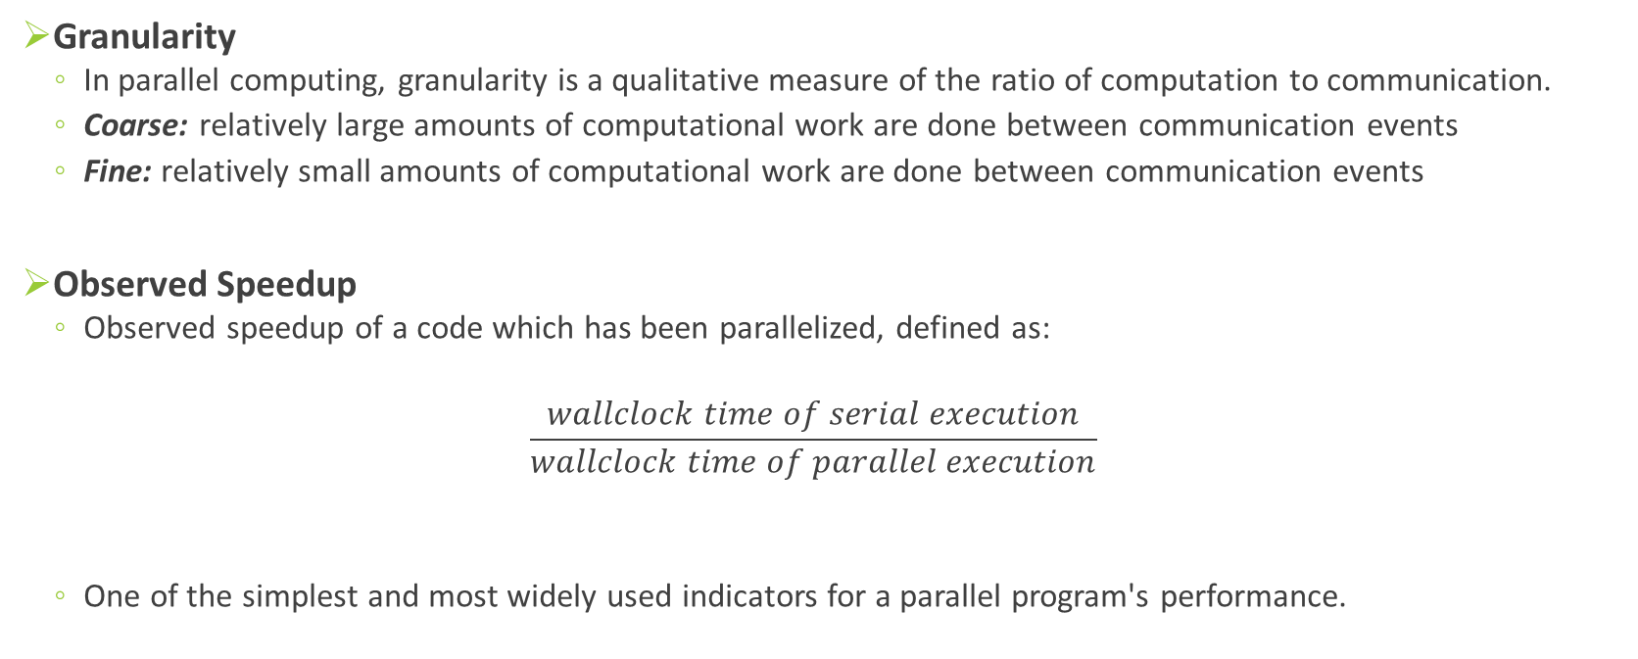
Granularity
In parallel computing, granularity is a qualitative measure of the ratio of computation to communication.
Coarse: relatively large amounts of computational work are done between communication events
Fine: relatively small amounts of computational work are done between communication events
Observed Speedup
Observed speedup of a code which has been parallelized, defined as:
$$\frac{wallclock time of serial execution}{wallclock time of parallel execution}$$
One of the simplest and most widely used indicators for a parallel program's performance.

Slide 36
Parallel Overhead
The amount of time required to coordinate parallel tasks, as opposed to doing useful work. Parallel overhead can include factors such as:
Task start-up time
Synchronizations
Data communications
Software overhead imposed by parallel compilers, libraries, tools, operating system, etc.
Task termination time
Massively Parallel
Refers to the hardware that comprises a given parallel system - having many processors. The meaning of many keeps increasing, but currently BG/L* pushes this number to 6 digits.
*Blue Gene is an IBM project aimed at designing supercomputers that can reach operating
speeds in the petaFLOPS (PFLOPS) range, with low power consumption.

Slide 37
Scalability
Refers to a parallel system's (hardware and/or software) ability to demonstrate a proportionate increase in parallel speedup with the addition of more processors.
Factors that contribute to scalabilty include:
Hardware - particularly memory-cpu bandwidths and network communications
Application Algorithm
Parallel overhead related
Characteristics of your specific application and coding

Slide 38
Parallel Computer Memory Architectures

Slide 39
Memory architectures
Shared Memory
Distributed Memory
Hybrid Distributed-Shared Memory

Slide 40
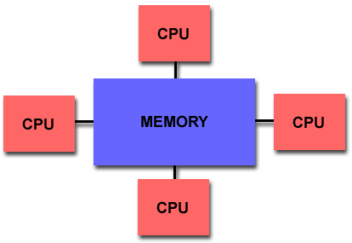
Shared Memory
Shared memory parallel computers vary widely, but generally have in common the ability for all processors to access all memory as global address space.
Multiple processors can operate independently but share the same memory resources.
Changes in a memory location effected by one processor are visible to all other processors.
Shared memory machines can be divided into two main classes based upon memory access times: UMA and NUMA.

Slide 41
Shared Memory : UMA vs. NUMA
Uniform Memory Access (UMA):
Most commonly represented today by Symmetric Multiprocessor (SMP) machines
Identical processors with equal access and access times to memory
Sometimes called CC-UMA - Cache Coherent UMA.
Non-Uniform Memory Access (NUMA):
Often made by physically linking two or more SMPs
One SMP can directly access memory of another SMP
Not all processors have equal access time to all memories
Notes:
Cache coherent means if one processor updates a location in shared memory, all the other processors know about the update. Cache coherency is accomplished at the hardware level.

Slide 42
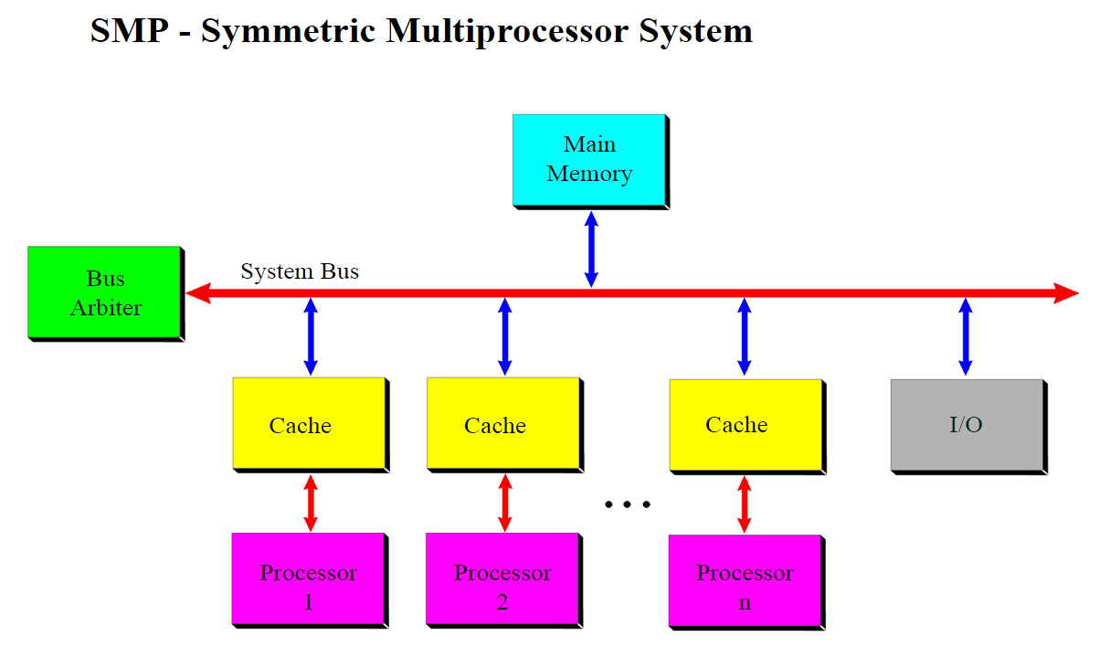

Slide 43
Shared Memory: Pro and Con
Advantages
Global address space provides a user-friendly programming perspective to memory
Data sharing between tasks is both fast and uniform due to the proximity of memory to CPUs
Disadvantages:
Primary disadvantage is the lack of scalability between memory and CPUs. Adding more CPUs can geometrically increases traffic on the shared memory-CPU path, and for cache coherent systems, geometrically increase traffic associated with cache/memory management.
Programmer responsibility for synchronization constructs that insure "correct" access of global memory.
Expense: it becomes increasingly difficult and expensive to design and produce shared memory machines with ever increasing numbers of processors.

Slide 44
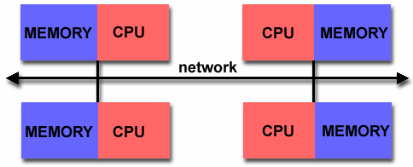
Distributed Memory
Like shared memory systems, distributed memory systems vary widely but share a common characteristic. Distributed memory systems require a communication network to connect inter-processor memory.
Processors have their own local memory. Memory addresses in one processor do not map to another processor, so there is no concept of global address space across all processors.
Because each processor has its own local memory, it operates independently. Changes it makes to its local memory have no effect on the memory of other processors. Hence, the concept of cache coherency does not apply.
When a processor needs access to data in another processor, it is usually the task of the programmer to explicitly define how and when data is communicated. Synchronization between tasks is likewise the programmer's responsibility.
The network "fabric" used for data transfer varies widely, though it can can be as simple as Ethernet.

Slide 45
Distributed Memory: Pro and Con
Advantages
Memory is scalable with number of processors. Increase the number of processors and the size of memory increases proportionately.
Each processor can rapidly access its own memory without interference and without the overhead incurred with trying to maintain cache coherency.
Cost effectiveness: can use commodity, off-the-shelf processors and networking.
Disadvantages
The programmer is responsible for many of the details associated with data communication between processors.
It may be difficult to map existing data structures, based on global memory, to this memory organization.
Non-uniform memory access (NUMA) times

Slide 46
Hybrid Distributed-Shared Memory
Comparison of Shared and Distributed Memory Architectures
Architecture | CC-UMA | CC-NUMA | Distributed
Examples | SMPs Sun Vexx DEC/Compaq SGI Challenge IBM POWER3 | Bull NovaScale SGI Origin Sequent HP Exemplar DEC/Compaq IBM POWER4 (MCM) | Cray T3E Maspar IBM SP2 IBM BlueGene
Communications | MPI Threads OpenMP shmem | MPI Threads OpenMP shmem | MPI
Scalability | to 10s of processors | to 100s of processors | to 1000s of processors
Draw Backs | Memory-CPU bandwidth | Memory-CPU bandwidth Non-uniform access times | System administration Programming is hard to develop and maintain
Software Availability | many 1000s ISVs | many 1000s ISVs | 100s ISVs

